Slide 1
Full stack web development with ASP.NET Core 3.0 and Blazor
Notes:
ASP.NET Core 3.0 is loaded with new features for building modern web applications and services. In this session, we'll show you how to use ASP.NET Core 3.0 to build beautiful and interactive client-side web UI with Blazor backed by high-performance gRPC microservices and long-running worker service processes. We’ll show you how to secure your APIs with IdentityServer integration, use SignalR for client-to-server streaming and take advantage of the latest performance improvements.

Slide 2














Your platform for building anything
DESKTOP
WEB
CLOUD
MOBILE
GAMING
IoT
AI
.NET
Notes:
You can build anything with .NET. We’ve made significant investments in .NET over the years as well as unifying the ecosystem to support building literally anything. From desktop to gaming to the cloud, .NET is a general purpose programming platform that enables all kinds of scenarios. Once you learn one, you can easily pick up another.

Slide 3
ASP.NET Core features
Hosting
Kestrel, Startup
Middleware
Routing, authentication, static files, diagnostics, error handling, session, CORS, localization, custom
Dependency Injection
Configuration
Logging
Application frameworks
Razor Pages, MVC, Identity, SignalR, Blazor, Workers, gRPC

Slide 4
Middleware

Slide 5
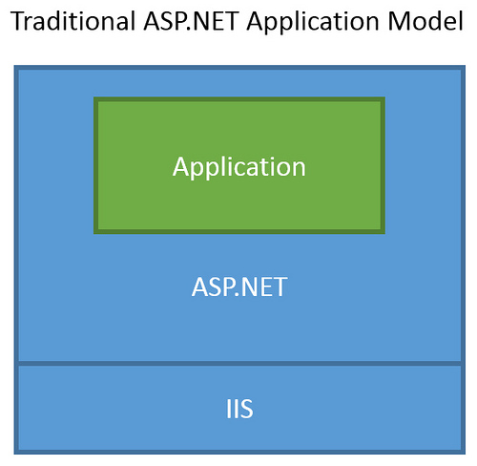
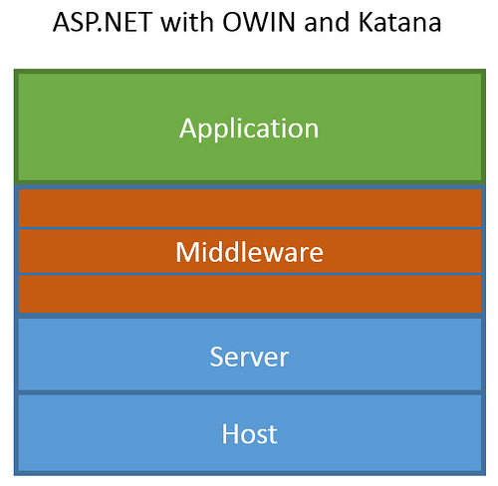
ASP.NET Core Middleware
Traditional ASP.NET Application Model
ASP.NET Core Middleware

Slide 6
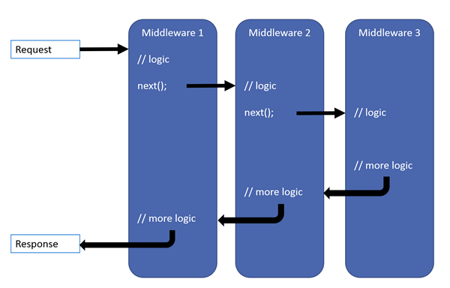
ASP.NET Core Middleware

Slide 7
Razor Pages

Slide 8
Razor Pages
Runs on all the same MVC infrastructure
Better encapsulation and grouping of UI details
Fewer folders and files
MVC
Razor Pages
/Controllers/CartController.cs
/ViewModels/CartViewModel.cs
/Views/Cart/Index.cshtml
3 Root Level Folders
/Pages/Cart/Index.cshtml
Index.cshtml.cs
1 Root Level Folder
Notes:
Reference (MSDN Magazine September 2017 - https://msdn.microsoft.com/en-us/magazine/mt842512)

Slide 9
@page
@using RazorPages
@model IndexModel
<p> @Model.Message </p>
using Microsoft.AspNetCore.Mvc.RazorPages;
using System;
namespace RazorPages {
public class IndexModel : PageModel
{
public string Message { get; private set; } = "Hello. ";
public void OnGet()
{
Message += $" Server time is { DateTime.Now }"; }
}
}
Notes:
https://docs.microsoft.com/en-us/aspnet/core/mvc/razor-pages/

Slide 10
MVC

Slide 11
What’s (pretty much) the same
MVC developer flow
Models / Views / Controllers
Routing / Attribute Routing
HTML Helpers

Slide 12
What’s Changed
No web.config (configuration)
No Global.asax or App_Start
No CSS / JS in project root (wwwroot)
bower and bowerrc
bundleconfig.json
New Program.cs / Startup.cs
Run with IISExpress / Kestrel

Slide 13
What’s new
(some aren’t MVC features but are useful for MVC dev)
Views get TagHelpers
DI more thoroughly integrated
Globalization / localization
MVC + APIs merged

Slide 14
TagHelpers
HTML helpers expressed as tags
Ex. Instead of:
@Html.LabelFor(m => m.UserName, new { @class = "col-md-2 control-label" })
Write this:
<label asp-for="UserName" class="col-md-2 control-label"></label>
Easier to customize with additional attributes
Work seamlessly with the HTML editor

Slide 15
TagHelpers
@using (Html.BeginForm(new { ReturnUrl = ViewBag.ReturnUrl })) {
@Html.AntiForgeryToken()
@Html.ValidationSummary(true)
<fieldset>
<legend>Log in Form</legend>
<ol>
<li>
@Html.LabelFor(m => m.UserName)
@Html.TextBoxFor(m => m.UserName)
@Html.ValidationMessageFor(m => m.UserName)
</li>

Slide 16
TagHelpers
<form anti-forgery=“true“ validation-summary=“true” action="Create“>
<fieldset>
<legend>Log in Form</legend>
<ol>
<li>
<label for=“UserName”>
<input for=“UserName”>
<span validation-for="Name" style="color:blue" />
</li>

Slide 17
TagHelpers: Create Your Own
public interface ITagHelper
{
int Order { get; }
Task ProcessAsync(TagHelperContext context, TagHelperOutput output);
}
Examples: https://github.com/aspnet/Mvc/tree/dev/src/Microsoft.AspNet.Mvc.TagHelpers

Slide 18
SPA Templates: Built on JavaScriptServices
Useful infrastructure for SPA’s on ASP.NET Core
Hosts Webpack to compile and serve client-side code
Advanced features like Hot Module Reloading and client / server side routing integration
Can invoke arbitrary NPM packages from .NET code
https://github.com/aspnet/JavaScriptServices

Slide 19
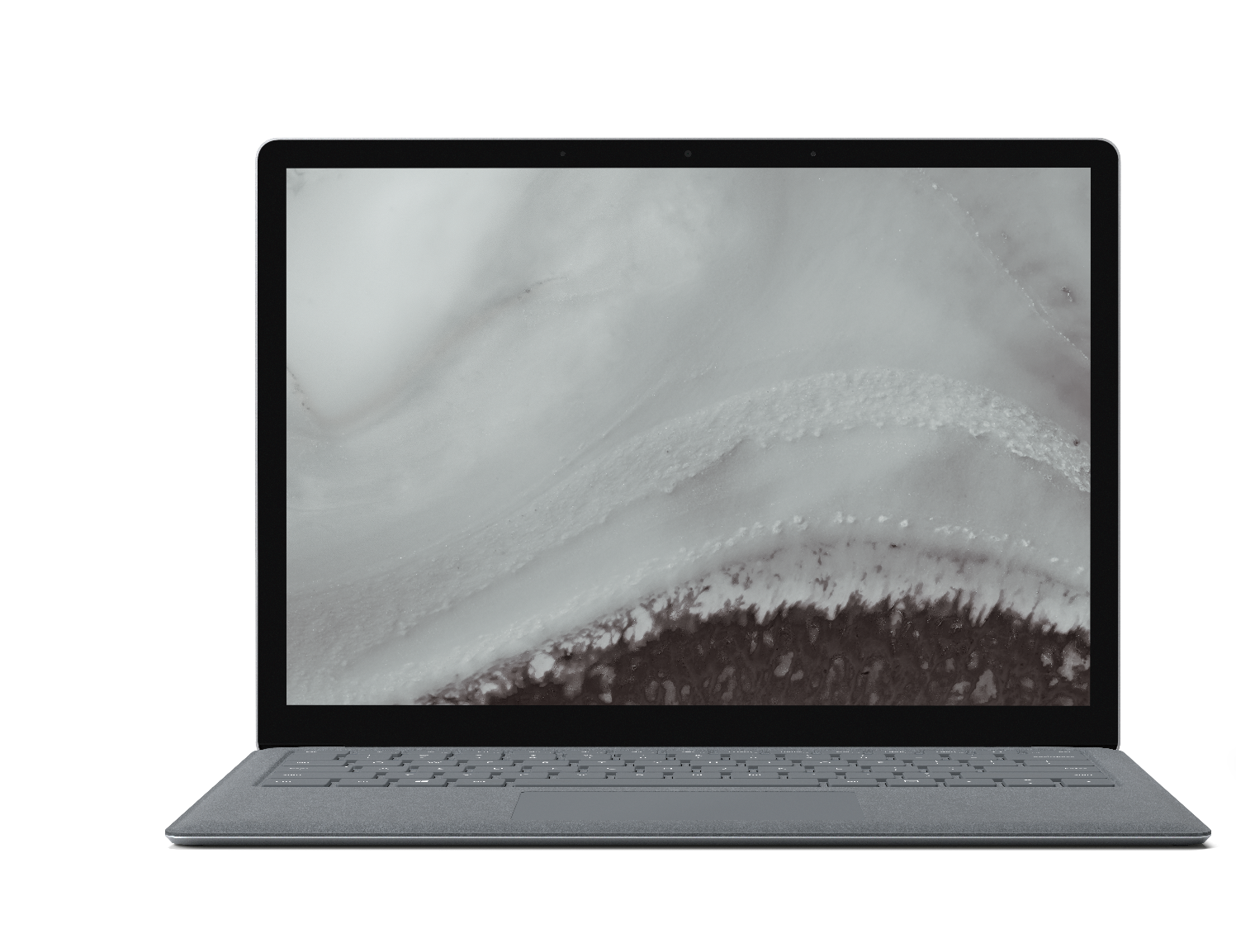
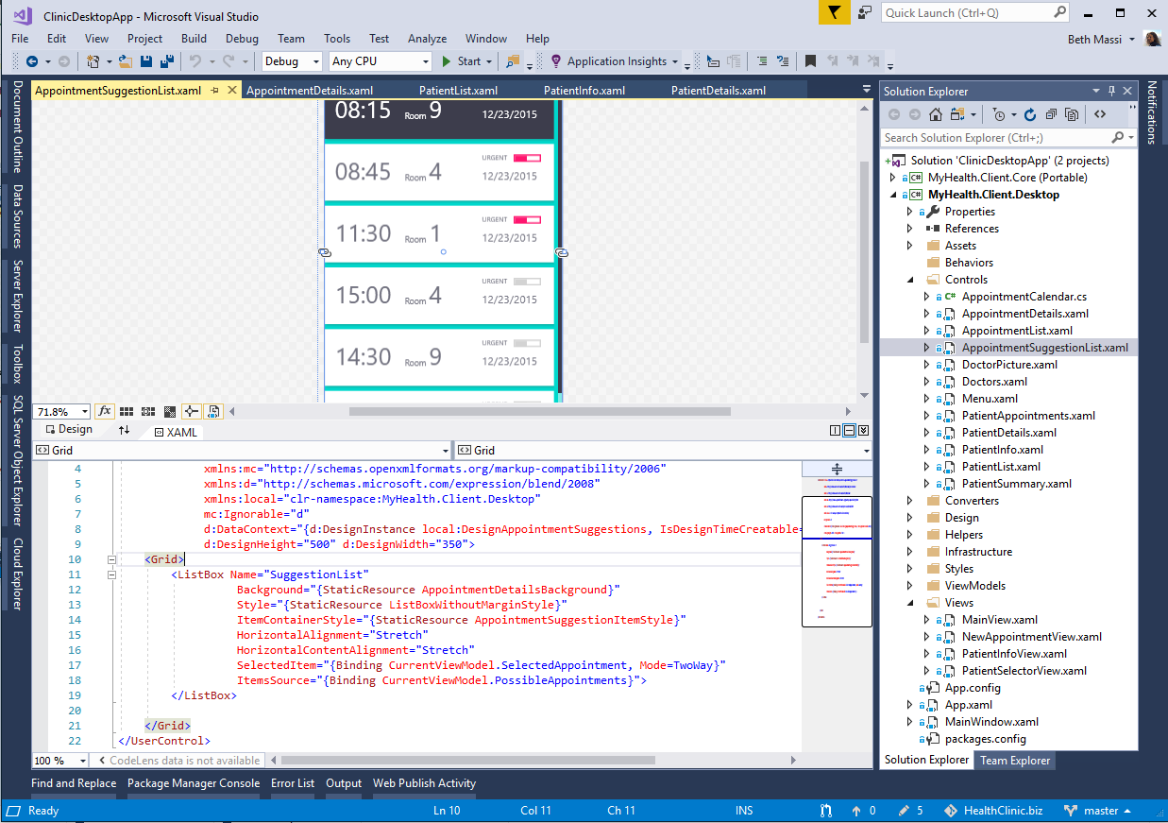
ANNOUNCING
.NET Core 3.0 Preview 5
Windows desktop support with WPF and WinForms, also open source
Flexible deployment, side-by-side support and self-contained EXEs
Full-stack web development with C# and Razor
Significant performance improvements
New C# language features for productivity and less errors
dot.net/get-core3
Notes:
We’re also announcing today the first preview of .NET Core 3. It comes with significant updates to desktop and server workloads.
.NET Core 3 brings Windows desktop development to .NET Core, with support for WinForms and WPF.
It enables more flexible deployment with side-by-side and self-contained EXEs.
We also have new features on the server side, including composable UIs with ASP.NET Core with Razor Components, which will provide full-stack web development with .NET for the first time.

Slide 20



.NET Core 3.0: A full stack solution
Client
Frontend
Backend
http://..
gRPC
gRPC
Worker
ASP.NET Core
Blazor
Components
SPA (JavaScript)
MVC / Razor Pages
Web APIs
SignalR
Security & identity
Worker services
gRPC

Slide 21


Blazor
Build client-side web UI with .NET instead of JavaScript
Write reusable web UI components with C# and Razor
Share .NET code with both the client and the server
Call into JavaScript libraries & browser APIs as needed
Blazor for WebAssembly now in official preview!
C#

Slide 22
Pizza store app architecture
gRPC
Order status
http://..
Worker
ASP.NET Core
Pizza Workers
Queue

Slide 23
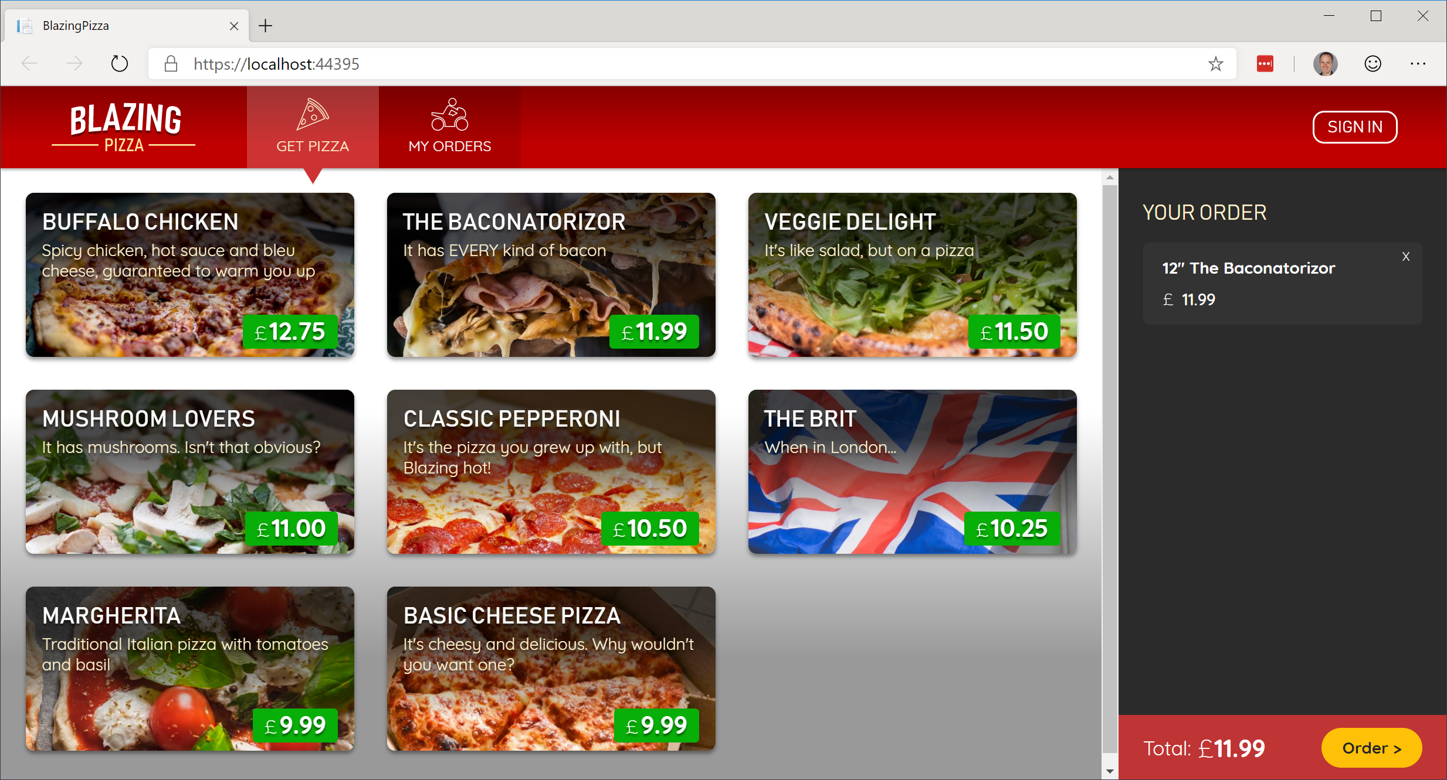
Build your own pizza store UI with Blazor
https://aka.ms/blazorworkshop

Slide 24



“Telerik UI for Blazor components have been built from the ground-up to ensure you experience shorter development cycles, quick iterations and cut time to market”
https://www.telerik.com/blazor-ui
“DevExpress UI for Blazor ships with 7 UI components (including a Data Grid and Pivot Grid) so you can design rich user experiences”
https://www.devexpress.com/blazor
“The Syncfusion ASP.NET Core Blazor Components library is the only suite that you will ever need to build an application, containing over 60 high-performance, lightweight, modular, and responsive UI controls in a single package.”
https://www.syncfusion.com/blazor-components

Slide 25


Blazor on client or server
Client-side
Server-side
https://...
https...
ASP.NET Core
Razor Components
DOM
SignalR
DOM
.NET
WebAssembly
Razor Components
.NET
Future
.NET Core 3.0

Slide 26
Pages & Views with Components
ASP.NET Core
Request
https...
Page / View
HttpContext
SignalR
Component
UI events / DOM updates
DOM
State
Response

Slide 27



Updated SPA templates
Angular 7*
React 16
Authentication support with IdentityServer
Angular
React
React+Redux

Slide 28
Authentication for SPA templates
Built-in client UI for login/logout
Easily protect server-side APIs
Protect specific parts of your client-side app from unauthorized access
Powered by IdentityServer
Notes:
Demo:
Show existing Angular + Auth app
Click on FetchData, redirects to login
Register user (using link below)
See FetchData page with logged in username
Click on user to see profile
Click on app home page link
Logout
Show code
Startup: DB, Identity, IdentityServer, API authorization setup
Angular: authorization module, route guard, token provider

Slide 29
Pizza store app architecture
gRPC
Order status
http://..
Worker
ASP.NET Core
Pizza Workers
Orders Queue

Slide 30
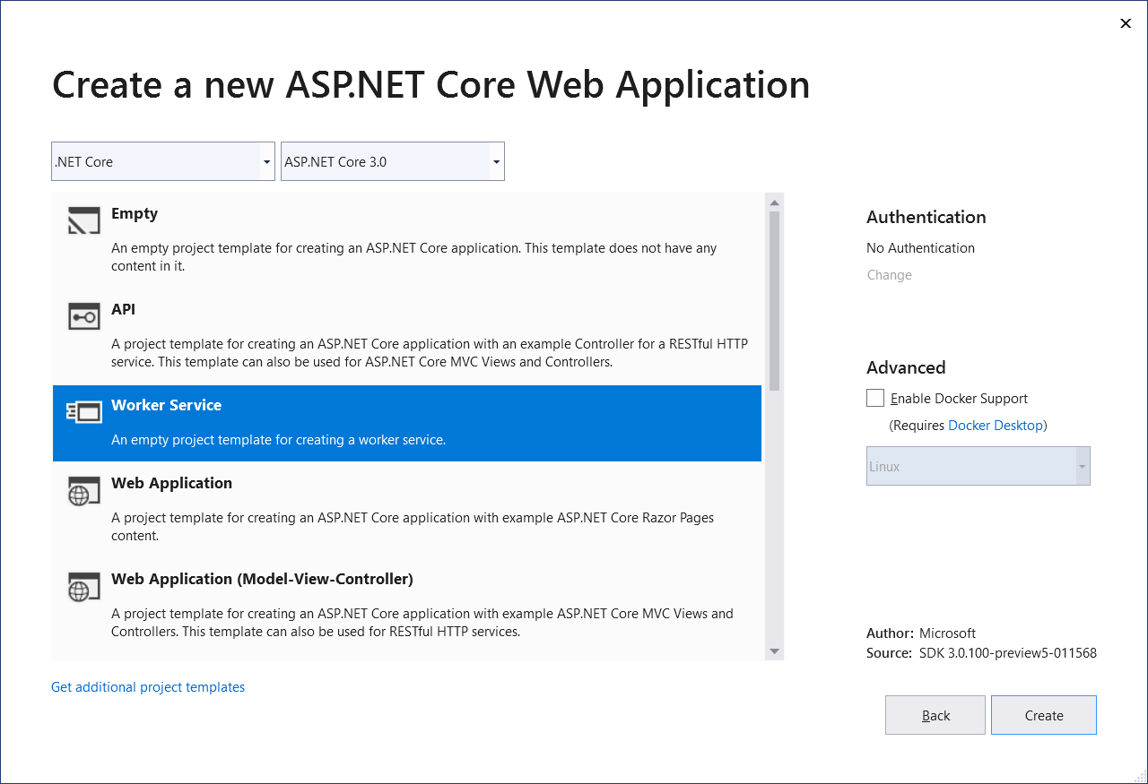
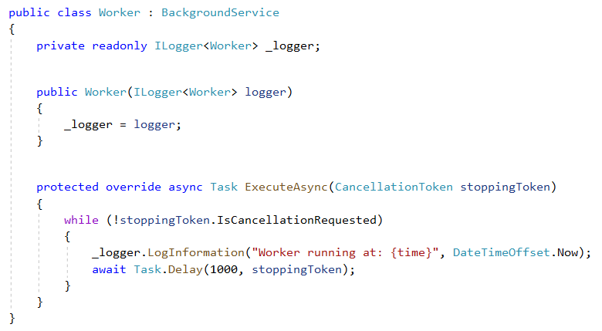
Worker services
New Worker service template
Build long-running worker processes
May or may not have endpoints
Host in Windows services, systemd, WebJobs, containers
Integrates with configuration, logging, dependency injection

Slide 31
Pizza store app architecture
gRPC
Order status
http://..
Worker
ASP.NET Core
Pizza Workers
Orders Queue

Slide 32
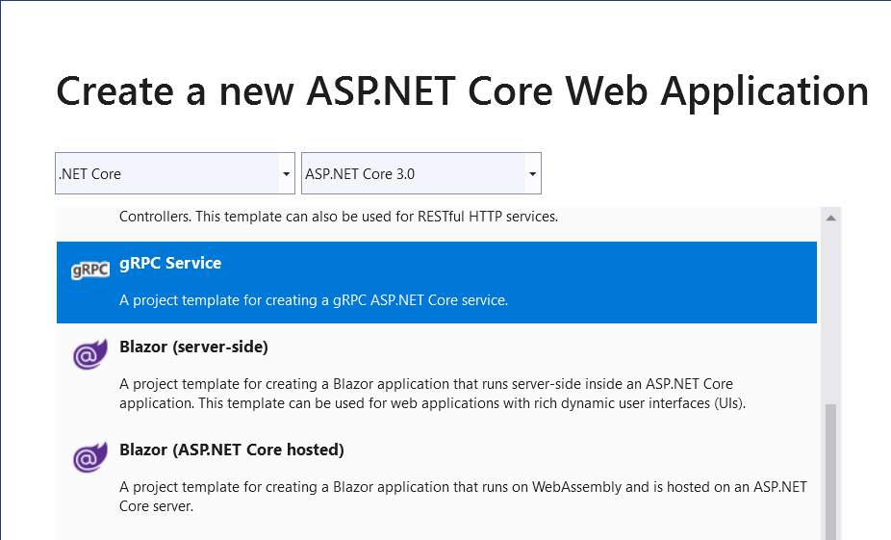
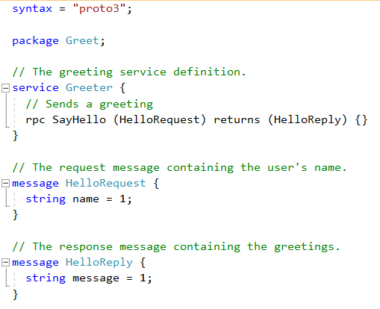
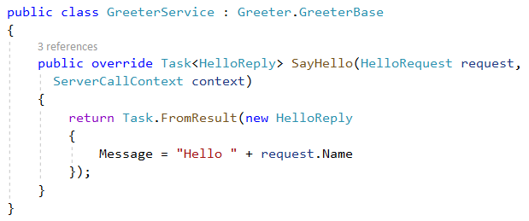
gRPC
High performance, contract-based RPC services
Broad interoperability for polyglot environments
Great for service-to-service communication

Slide 33



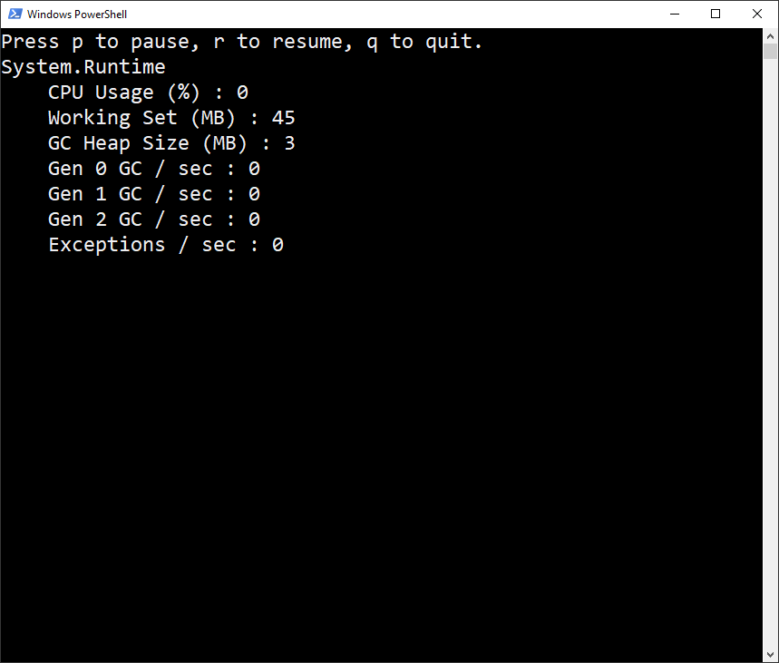
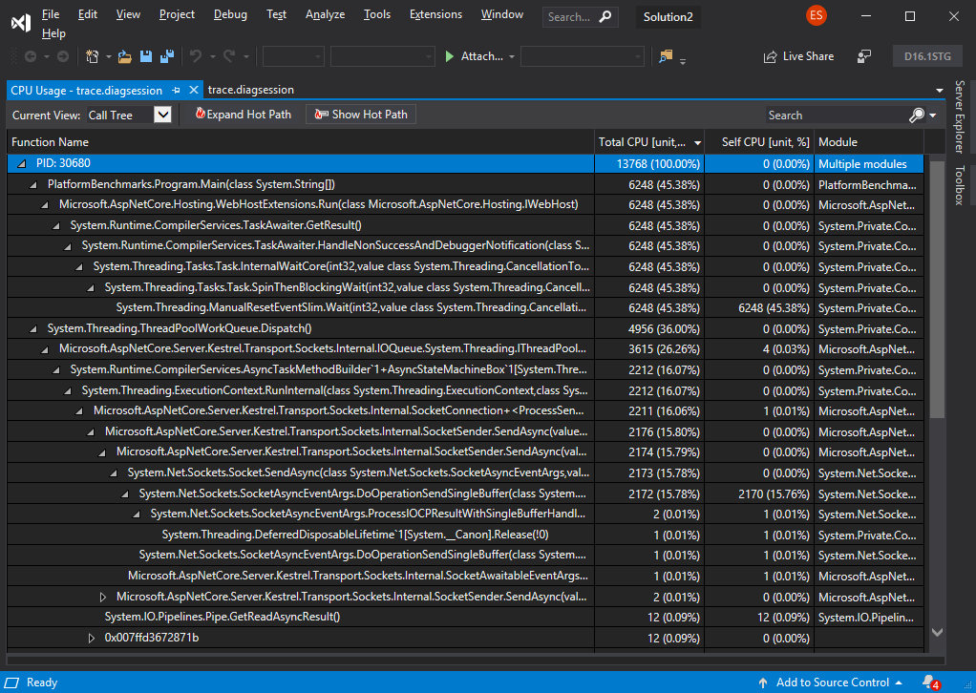
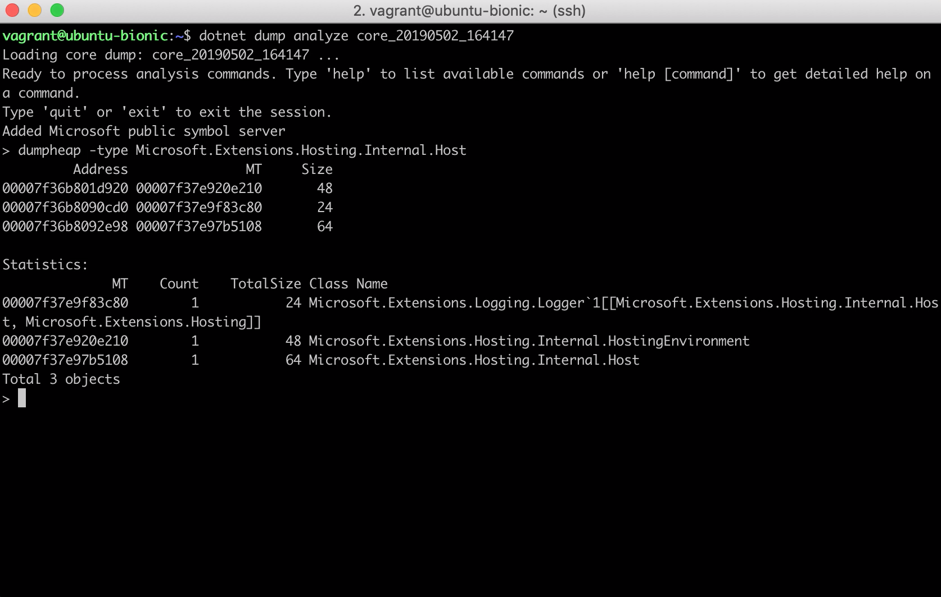
Diagnostics
Counters
Traces
Dumps
dotnet counters
dotnet trace
dotnet dump
Runtime emits metrics via EventCounters
Ad-hoc analysis and monitoring
ASP.NET Core specific counters coming soon
Generate portable trace files
Analyze with perfview, Visual Studio, or third-party apps (speedscope.app)
Collect .NET Core process dumps
Analyze dumps with an interactive REPL (hosted version of SOS)

Slide 34
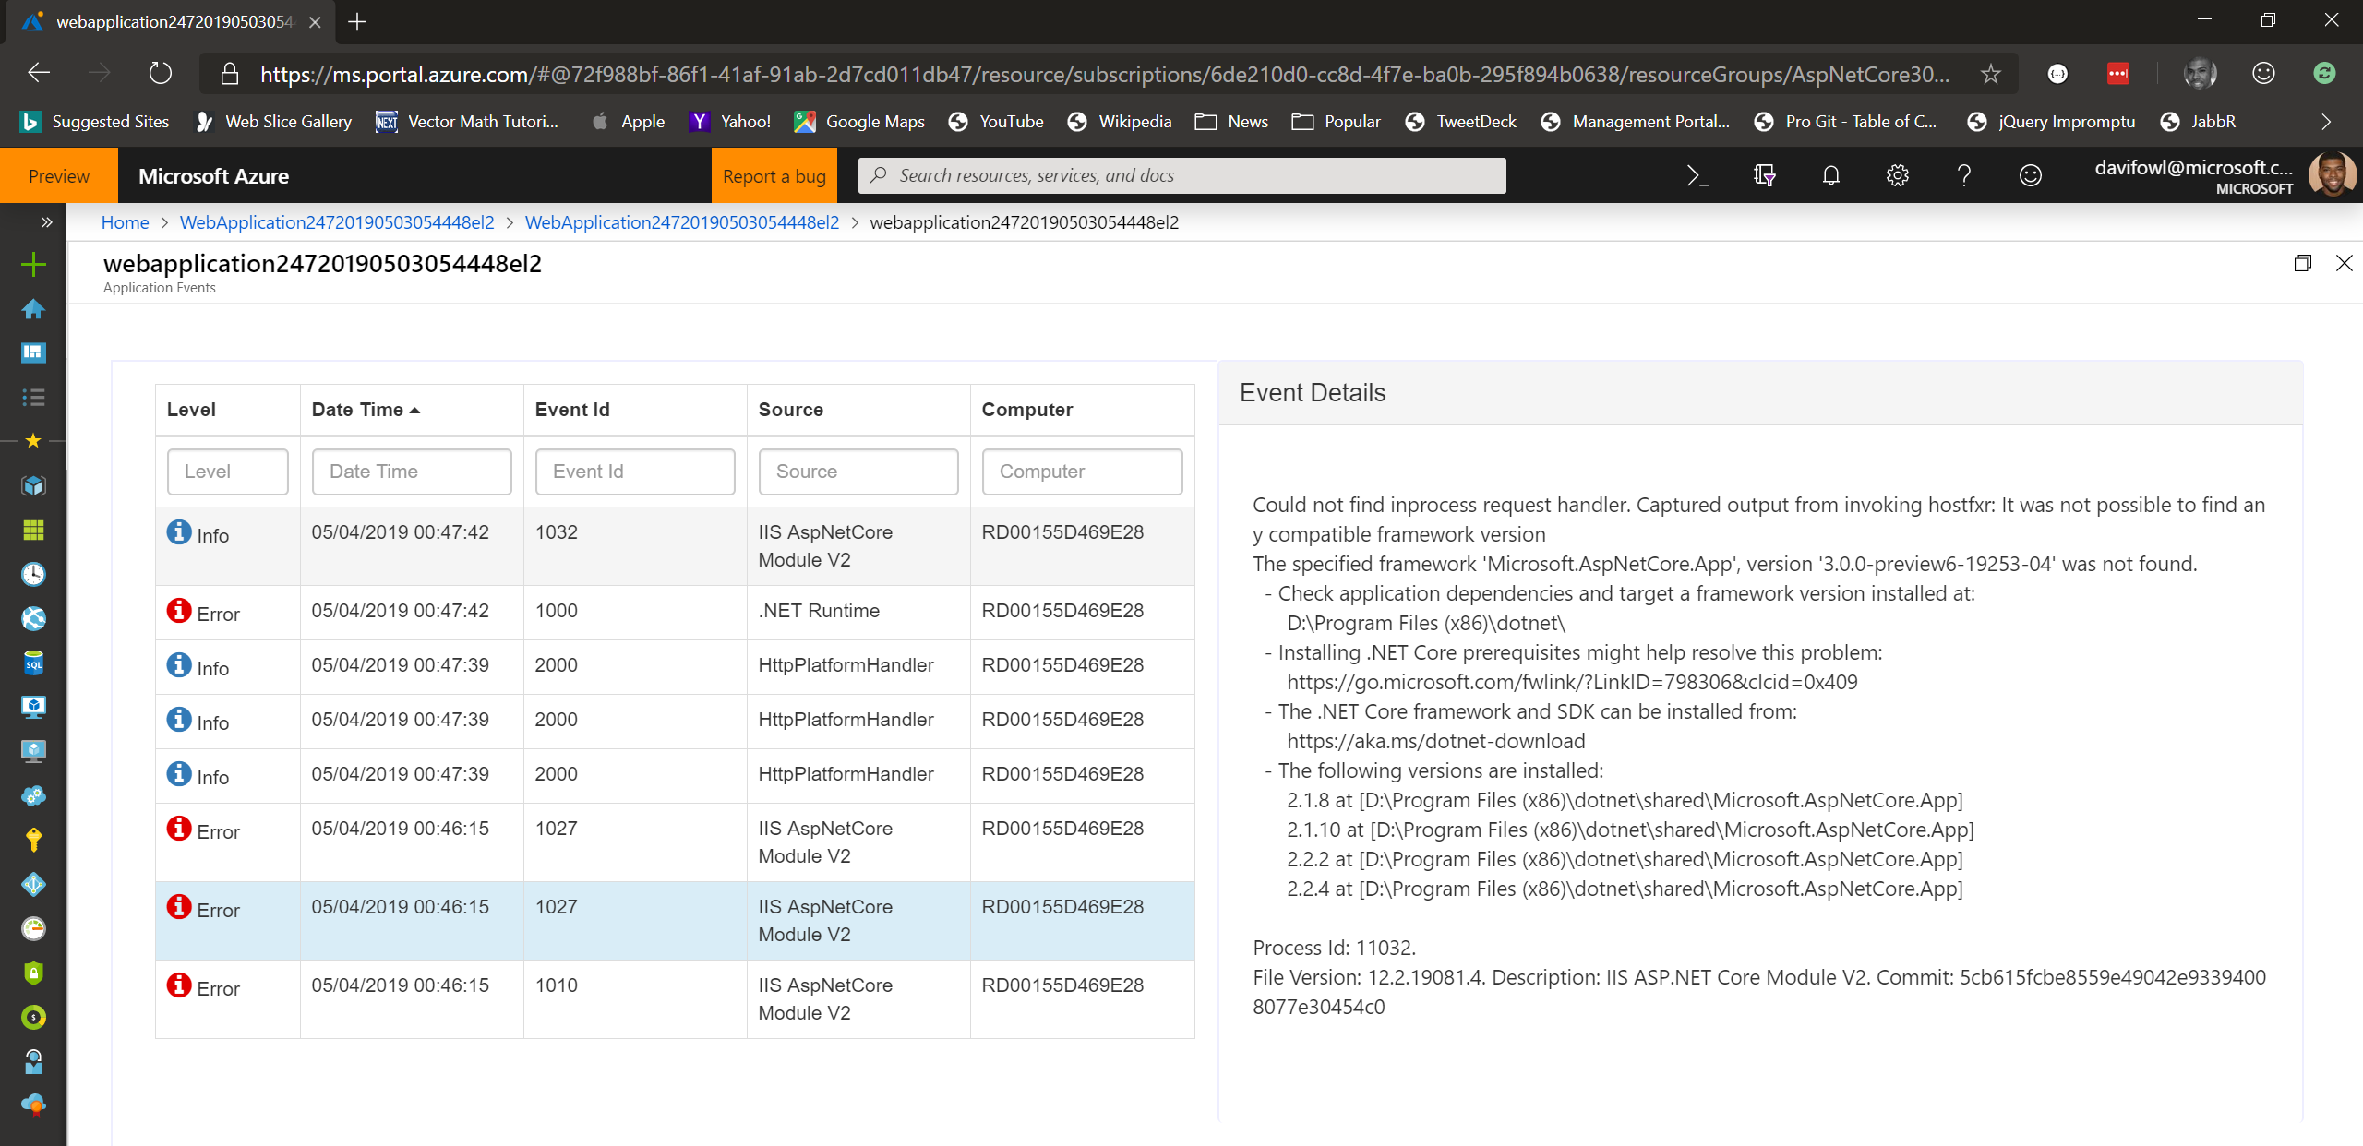
Azure portal experience

Slide 35

Performance Improvements
Plaintext (MW)
JSON (MW)
JSON (MVC)
Fortunes (MW)
2.2
3.1M RPS
650 ms TTFR
1,342 MB
690K RPS
768 ms TTFR
1,205 MB
373K RPS
1,324 ms TTFR
1,198 MB
248K RPS
1,325 ms TTFR
1,268 MB
3.0
4.35M RPS
356 ms TTFR
103 MB
+39%
-45%
-92%
785K RPS
476 ms TTFR
516 MB
+13%
-38%
-57%
438K RPS
661 ms TTFR
528 MB
+15%
-50%
-56%
261K RPS
990 ms TTFR
733 MB
+5%
-25%
-42%
Where did the improvements come from?
Reducing allocations (Plaintext is now “allocation-free”)
Endpoint Routing
Tiered Compilation JIT
Improved GC memory reservation defaults
And we’re not finished yet…
All results taken from https://aka.ms/aspnet/benchmarks on Linux
Notes:
RPS = requests per second
MW = middleware
TTFR = time to first request

Slide 36
Also new in ASP.NET Core 3.0
Simplified shared framework
Blazor (server-side)
gRPC
Worker
IdentityServer
API code generation
Endpoint routing integration
C# 8 in Razor & MVC
JSON
Windows service support
SignalR auto-reconnect, streaming
SignalR C++ client*
Event counters*
Certificate & Kerberos authentication*
Performance
*Coming soon!

Slide 37
Schedule
Preview 5 - Now available!
Preview 6 - June
Preview 7 (go-live) - July
Preview 8 (go-live) - Aug
GA - Sept

Slide 38
Try .NET Core 3.0 with ASP.NET Core & Blazor today!
Download: https://dot.net/get-core3
Visual Studio: https://visualstudio.com/preview
Docs: https://docs.asp.net
Blazor: https://blazor.net
Workshop: https://aka.ms/blazorworkshop

Slide 39
Lab
Razor Pages

Slide 40
Lab
Building an ASP.NET Core Site using CLI

Slide 41
Lab
Blazor

Slide 42
Lab
Tag Helpers

Slide 43
Lab
SPA Template

